Slide 1
University of Technical Education of Ho Chi Minh City
NETWORKING ESSENTIALS
Chapter 6.
Wireless LAN
Huynh Nguyen Chinh
Notes:
1

Slide 2
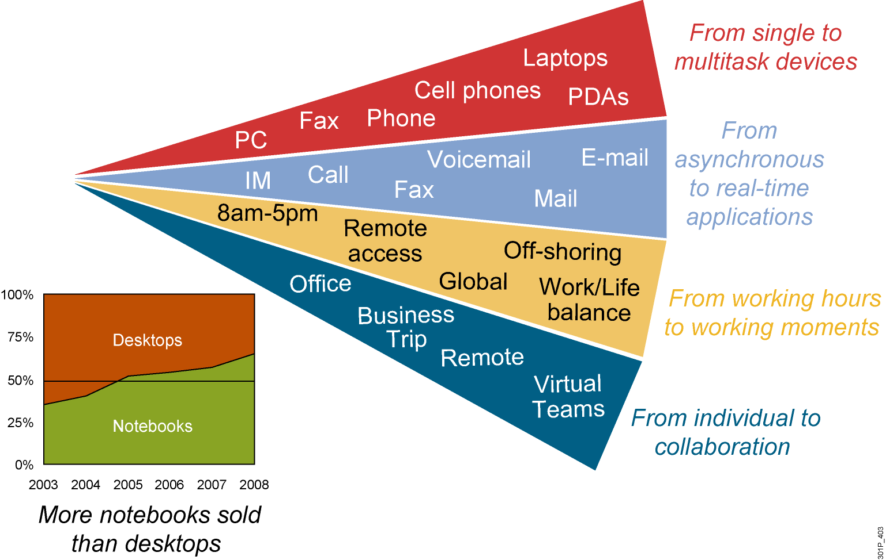
Market Trends
Notes:
People are no longer restricted to traveling to fixed work location for defined periods of time for productivity. People are now expecting to be connected at any time at any place. This change in environment reaches far from the office to many location such as airport or even the home. Traveling employees used to be restricted to pay phones for checking messages and returning a few phone calls between flights. Now employees can check email, voice mail, and the web status of products on PDAs while walking to the flight.
Even at home people have changed the way they live and learn. The internet has became more of a standard at homes along side of TV and phone service. Even the method of accessing the Internet has quickly moved from temporary modem dial service to dedicated DSL or cable service that is always connected and with greater speed. More recently during 2005 users of PCs are purchasing more Wi-Fi enabled mobile laptops instead of a fixed location desktop.

Slide 3
Differences Between WLAN and LAN
WLANs use radio waves as the physical layer.
WLANs use CSMA/CA instead of CSMA/CD for media access.
Two-way radio (half-duplex) communication.
Radio waves have problems that are not found on wires.
Connectivity issues:
Coverage problems
Interference, noise
Privacy issues
Access points are shared devices similar to an Ethernet hub for shared bandwidth.
WLANs must meet country-specific RF regulations.
Notes:
Following is an explanation of how WLANs differ from LANs.
-> In WLANs, radio frequencies are used as the physical layer of the network.
- WLANs use CSMA/CA (Carrier Sense Multiple Access with Collision Avoidance) instead of CSMA/CD (Carrier Sense Multiple Access with Collision Detection) that is used by Ethernet LANs. Collision detection is not possible because a sending station cannot receive at the same time that it is transmitting and, therefore, cannot detect a collision. Instead, the Request to Send (RTS) and Clear to Send (CTS) protocols are used to avoid collisions.
- WLANs use a different frame format than wired Ethernet LANs. Additional information for WLAN is required in the Layer 2 header of the frame.
-> Radio waves have problems not found in wires.
- Connectivity issues in WLANs can be caused by coverage problems, RF transmission, multipath distortion, and interference from other wireless services or other WLANs.
- Privacy issues are possible because radio frequencies can reach outside the facility.
-> In WLANs, mobile clients connect to the network through an access point which is the equivalent for a wired ethernet hub.
- Mobile clients do not have a physical connection to the network.
- Mobile devices are often battery powered as opposed to being electrically powered as they are for LANs.
-> WLANs must meet country-specific RF regulations.
- The aim of standardization is to make WLANs available worldwide. Because WLANs use radio frequencies, they must follow country-specific regulations of RF power and frequencies. This requirement does not apply to wired LANs.

Slide 4
Radio Frequency Transmission
Radio frequencies are radiated into the air via an antenna, creating radio waves.
Objects can affect radio wave propagation resulting in:
Reflection
Scattering
Absorption
Higher frequencies allow higher data rates; however, they have a shorter range.
Notes:
Radio frequencies are radiated into the air by antennas that create radio waves. When radio waves are propagated through objects, they may be absorbed by some objects (for instance, walls) and reflected by other objects (for instance, metal surfaces). This absorption and reflection may cause areas of low signal strength or low signal quality.
The transmission of radio waves is influenced by the following factors:
Reflection: Occurs when radio frequency (RF) waves bounce off objects (for example, metal or glass surfaces).
Scattering: Occurs when RF waves strike an uneven surface (for example, a rough surface) and are reflected in many directions.
Absorption: Occurs when RF waves are absorbed by objects (for example, walls).
The following rules apply for data transmission over radio waves:
Higher data rates have a shorter range because the receiver requires a stronger signal with a better signal to noise ratio (SNR) to retrieve the information.
Higher transmit power results in greater range. To double the range, the power has to be increased by a factor of 4.
Higher data rates require more bandwidth. Increased bandwidth is possible with higher frequencies.
Higher frequencies have a shorter transmission range through higher degradation and absorption. This fact can be compensated with more efficient antennas.

Slide 5


Organizations That Define WLAN
ITU-R:
International Telecommunication Union-Radiocommunication Sector
Regulates the RF used in wireless
IEEE:
Institute of Electrical and Electronic Engineers
802.11 documents wireless technical standards
Wi-Fi Alliance:
Global nonprofit industry trade association
Promote wireless growth through interoperability certification
Notes:
Regulatory agencies control the use of the RF bands. With the opening of the 900-MHz ISM band in 1985, the development of WLANs started. New transmissions, modulations, and frequencies depend on the approval of the regulatory agencies. A worldwide consensus is required. Regulatory agencies include the Federal Communications Commission (FCC) for the United States (http://www.fcc.gov) and the European Telecommunications Standards Institute (ETSI) for Europe (http://www.etsi.org).
The IEEE defines standards. 802.11 is part of the 802 networking standardization. You can download ratified standards from the IEEE website (http://standards.ieee.org/getieee802).
The Wi-Fi Alliance offers certification for interoperability between vendors of 802.11 products. This certification provides a comfort zone for the users who are purchasing the products. It also helps to market the WLAN technology by promoting interoperability between vendors. Certification includes all three 802.11 RF technologies and Wi-Fi Protected Access (WPA), a security model released in 2003 based on the new security standard IEEE 802.11i, which was ratified in 2004. The Wi-Fi promotes and influences WLAN standards. Ratified products can be found on the Wi-Fi website (http://www.wi-fi.org).

Slide 6
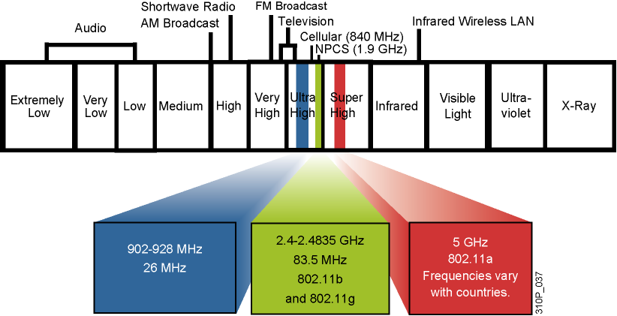
ITU-R with FCC Wireless
ISM: industry, scientific, and medical frequency band
No license required
No exclusive use
Best-effort
Interference possible
Notes:
There are three unlicensed bands: 900 MHz, 2.4 GHz, and 5.7 GHz. The 900-MHz and 2.4‑GHz bands are referred to as the Industrial, Scientific, and Medical (ISM) bands, and the 5‑GHz band is commonly referred to as the Unlicensed National Information Infrastructure (UNII) band.
Frequencies for these bands are as follows:
900-MHz band: 902 MHz to 928 MHz.
2.4-GHz band: 2.400 MHz to 2.483 GHz. (In Japan, this band extends to 2.495 GHz.)
5-GHz band: 5.150 MHz to 5.350 MHz, 5.725 MHz to 5.825 MHz, with some countries supporting middle bands between 5.350 MHz and 5.825 MHz. Not all countries permit 802.11a, and the available spectrum varies widely. The list of countries that permit 802.11a is changing.
The figure shows WLAN frequencies. Next to the WLAN frequencies in the spectrum are other wireless services such as cellular phones and NPCS (Narrowband Personal Communication Services). The frequencies used for WLAN are ISM bands.
Unlicensed frequency bands do not require a license to operate wireless equipment. However, there is no exclusive use of a frequency for a user or a service. For example, the 2.4-GHz band is used for WLANs, video transmitters, Bluetooth, microwave ovens, and portable phones. Unlicensed frequency bands offer a best-effort use, and interference and degradations are possible.
Even though three frequency bands do not require a license to operate equipment, they still have certain local country code regulations inside the frequencies to limit characteristics such as transmitter power, antenna gain which increases the effective power, and the total summation of transmitter, cable, and antenna.
Effective Isotropic Radiated Power (EIRP) is the final unit of measurement used by local country regulatory. Therefore caution should be used when attempting to replace a component of wireless equipment such as an antenna to increase range. The possible result could be a total wireless system that is illegal for the local codes.
EIRP = transmitter power + antenna gain - cable loss
Note : Only use antennas and cables supplied by the original manufacture listed for the specific access point implementation. Only used qualified technicians who understand the many different variations and requirement to comply with local RF country regulatory codes.

Slide 7
IEEE 802.11 Standards Comparison
 | 802.11b | 802.11a | 802.11g
Frequency band | 2.4 GHz | 5 GHz | 2.4 GHz
No. of channels | 3 | Up to 23 | 3
Transmission | Direct Sequence Spread Spectrum (DSSS) | Orthogonal Frequency Division Multiplexing (OFDM) | Direct Sequence Spread Spectrum (DSSS) | Orthogonal Frequency Division Multiplexing (OFDM)
Data rates [Mb/s] | 1, 2, 5.5, 11 | 6, 9, 12, 18, 24, 36, 48, 54 | 1, 2, 5.5, 11 | 6, 9, 12, 18, 24, 36, 48, 54
Notes:
The original 802.11 wireless standard was completed in June 1997, revised in 1999 (802.11a/b) and reaffirmed in 2003 (802.11g). The IEEE standard defines the physical layers and MAC sub-layer of the Data-Link layer of the OSI model. Be design the standard does not address upper layers of the OSI model. Three modulation techniques of Infrared (IR), Frequency Hopping Spread Spectrum (FHSS), and Direct Sequence Spread Spectrum (DSSS) where originally defined. Light based IR medium quickly became obsolete leaving FHSS and DSSS for most implementations. FHSS transmissions jump frequencies in a defined algorithm to minimize interference while DSSS uses just one channel that spreads the data across all frequencies defined by that channel. Since both technologies use a different approach to minimizing interference, they are mutually incompatible. The IEEE 802.11 divided the 2.4GHz ISM band into 14 channels, however local regulatory such as FCC designate which channels are allowed such as channels 1 through 11 for FCC in the United States. Each channel of 2.4 GHz ISM band is 22 MHz wide with 5 MHz separation resulting in overlap with channels before or after a defined channel for usage. Therefore a separation of 5 channels is needed to ensure unique non-overlapping channels. Given the FCC example of 11 channels, the maximum of non-overlapping frequencies are channels 1, 6, and 11.
Recall earlier that wireless is a half-duplex communication and therefore the basic throughput is only about half of the data rate. Therefore, IEEE 802.11b main development goal was to achieve higher data rates within the 2.4 GHz ISM band and therefore continue the growing Wi-Fi consumer market and acceptance.
802.11b defined the usage of DSSS with newer encoding or modulation of Complementary Code Keying (CCK) for higher data rates of 5.5, and 11 Mbps over that prior Barker Coding of 1 and 2 Mbps. 802.11b still used the same 2.4 GHz ISM band and was backward compatible with prior 802.11 and it’s associated data rates of 1 and 2 Mbps.
During the same year as 802.11b, IEEE developed another amendment known as 802.11a. This standard was motivated by the continued goal of increasing data rate through a different Orthogonal Frequency Division Multiplexing (OFDM) spread spectrum and modulation technology and to use a less crowded frequency of 5 GHz UNII. The 2.4 GHz ISM band was widely used for all thing wireless such as Bluetooth, cordless phones, monitors, video, home gaming consoles, and also happens to be the same frequency used by microwave ovens to heat water and food at high energy. The 802.11a was not as widely known since materials for chip manufacturing was less readily available and initially resulted in higher cost. Most all applications requirements were satisfied by the cheaper and widely available 802.11b.
A more recent development by IEEE to maintain usage of the 802.11 MAC and obtain higher data rates in the 2.4 GHz ISM band. This resulting IEEE 802.11g amendment used newer OFDM from 802.11a for higher speeds, yet was backward compatible with 802.11b using DSSS since it was already using the same ISM frequency band. Therefore DSSS data rates of 1, 2, 5.5, and 11 Mbps are supported plus OFDM data rates of 6, 9, 12, 18, 24, 48, and 54 Mbps although IEEE only require mandatory data rate of OFDM using 6, 12, 24 Mbps regardless of 802.11a or 802.11g OFDM.

Slide 8
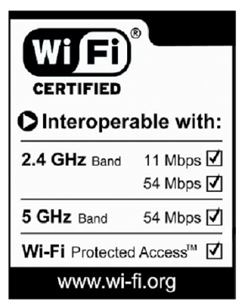
Wi-Fi Certification
Wi-Fi Alliance certifies interoperability between products.
Products include 802.11a, 802.11b, 802.11g, dual-band products, and security testing.
Provides assurance to customers of migration and integration options.
Cisco is a founding member of the Wi-Fi Alliance.
Certified products can be found at http://www.wi-fi.com.
Notes:
The Wi-Fi Alliance is a global, nonprofit industry trade assocation devoted to promoting the growth and acceptance of wireless LANs. One of the primary benefits of the Wi-Fi Alliance is to ensure interoperability among 802.11 products offered by various vendors by providing certification. This certification provides a comfort zone for the users purchasing the products because of the certified vendor interoperability. Certification includes all three IEEE 802.11 RF technologies, as well as early adaption of pending IEEE drafts such as security. The Wi-Fi Alliance adapted IEEE 802.11i draft security as Wi-Fi Protected Access (WPA), and then revised to WPA2 after final release of IEEE 802.11i.

Slide 9
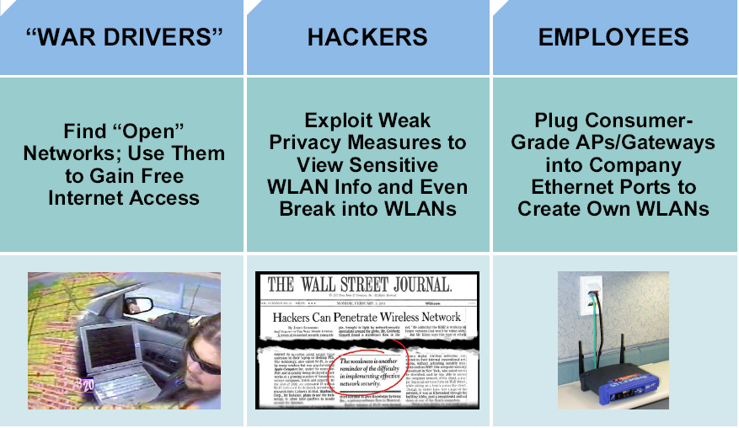
Wireless LAN Security Threats
Notes:
With the lower costs of IEEE 802.11b/g systems, it is inevitable that hackers will have many more unsecured WLANs from which to choose.
Incidents have been reported of people using numerous open source applications to collect and exploit vulnerabilities in the IEEE 802.11 standard security mechanism, Wired Equivalent Privacy (WEP).
Wireless sniffers enable network engineers to passively capture data packets so that they can be examined to correct system problems. These same sniffers can be used by hackers to exploit known security weaknesses.
“War driving” is a phrase that was originally used to describe someone who is using a cellular scanning device looking for cell phone numbers to exploit. War driving also refers to someone driving around with a laptop and an 802.11b/g client card looking for an 802.11b/g system to exploit.
Most wireless devices sold today are wireless network ready. End users often do not change default settings or they implement only standard WEP security, which is not optimal solution for secure wireless networks.
With basic WEP encryption enabled (or, obviously, with no encryption enabled), it is possible to collect data and obtain sensitive network information, such as user login information, account numbers, and personal records.
A rogue AP is an AP that has been placed on a WLAN and that might be used to interfere with normal network operations (DoS attacks, for example). If this rogue AP is programmed with the correct WEP key, client data may be captured. This AP may also be configured to provide unauthorized users with information about the network, such as MAC addresses of clients (both wireless and wired), the ability to capture and spoof data packets, and at worst, access to servers and files. A simple and common version of rogue AP are those employees unknowning install. Employees install access points intended for home use without the necessary security configuration on the enterprize network causing a security risk for the network.

Slide 10
Mitigating the Threats
Control and Integrity | Privacy and Confidentiality | Protection and Availability
Authentication | Encryption | Intrusion Prevention System (IPS)
Ensure that legitimate clients associate with trusted access points. | Protect data as it is transmitted and received. | Track and mitigate unauthorized access and network attacks.
Notes:
To secure a WLAN, the following steps are required:
- Authentication to ensure that legitimate clients and users access the network via trusted access points
- Encryption for providing privacy and confidentiality
- Protection from security risks and availability with intrusion detection and intrusion protection systems for WLANs
The fundamental solution for wireless security is authentication and encryption to protect the wireless data transmission. These two wireless security solution can be implemented in a various degrees, however both apply to SOHO and large enterprise wireless networks. Larger enterprise networks will need additional levels of security offered by Intrusion Detection Systems (IDS) monitor. Current IDS systems can not only detect wireless network attacks, but also provide basic mitigation against foreign clients and access points. Many enterprise networks use IDS not just for protection against outside threats, but mainly for unintentional unsecured access points installed by employees desiring the mobility and benefits of wireless.

Slide 11
Evolution of Wireless LAN Security
1997
2001
2003
2004 to Present
WEP
802.1x EAP
WPA
802.11i / WPA2
Basic encryption
No strong authentication
Static, breakable keys
Not scalable
MAC filters and SSID-cloaking also used to complement WEP
Dynamic keys
Improved encryption
User authentication
802.1X EAP (LEAP, PEAP)
RADIUS
Standardized
Improved encryption
Strong, user authentication (such as, LEAP, PEAP, EAP-FAST)
AES strong encryption
Authentication
Dynamic key management
Notes:
The figure shows the evolution of wireless LAN (WLAN) security.
Initially, IEEE 802.11 security only defined 64-bit static WEP keys for both encryption and if used authentication. The 64-bit key contained the actual 40-bit key plus 24-bit Initialization Vector (IV). The authentication method was not strong and the keys were eventually compromised. Because the keys were administered statically, this method of security was not scalable to large enterprise environments. Enterprise companies tried to supplement this weakness with techniques using SSID and MAC address filtering.
The SSID is a network-naming scheme and configurable parameter that both the client and the AP must share. If the client does not have the proper SSID advertised from the access point configured to not broadcast the SSID (SSID Cloaking), it is unable to associate with the AP and would have no access to the network. The problem with the effort was that 802.11 allows wireless client to use a null string (no value entered into the SSID field) thereby requesting that the AP to broadcast its SSID rendering the security effort ineffective. Access point also supported filtering using a MAC address. Tables are manually constructed on the AP to allow or disallow clients based upon their physical hardware address. However MAC addresses may be relatively easily spoofed and MAC address filtering is not considered a security feature either.
While 802.11 committee then began the process of upgrading the security of the WLAN, Enterprise customers needed wireless security immediately to enable deployment. Driven by customer demand, Cisco introduced early proprietary enhancements to RC4-based WEP encryption. Cisco implemented Cisco’s Temporal Key Integrity Protocol (CKIP) per-packet keying or hashing and Cisco’s Message Integrity Check (CMIC) to protect WEP keys. Cisco also adapted the use of IEEE 802.1X wired authentication protocols on wireless and dynamic keys using Lightweight EAP (LEAP) to a centralized database.
Soon after Cisco wireless security implementation, the Wi-Fi Alliance introduced Wi-Fi Protected Access (WPA) as an interim solution that was a subset of the expected 802.11i security standard for WLANs using 802.1X authentication and improvements to WEP encryption. The newer key hashing (TKIP versus CKIP) and message integrity check (MIC versus CMIC) where similar in feature but not compatible.
Today IEEE 802.11i has been ratified and Advanced Encryption Standard (AES) has replaced Wired Equivalent Privacy (WEP) as the latest and most secure method of encrypting data. Wireless intrusion detection systems are available to identify and protect the WLAN from attacks. The Wi-Fi Alliance certifies 802.11i devices under Wi-Fi Protected Access 2 (WPA2).

Slide 12
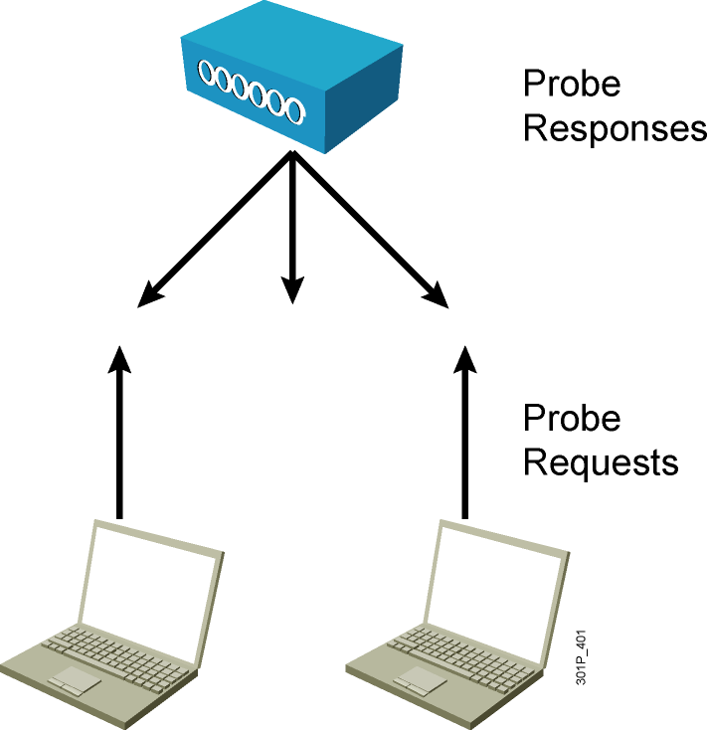
Wireless Client Association
Access points send out beacons announcing SSID, data rates, and other information.
Client scans all channels.
Client listens for beacons and responses from access points.
Client associates to access point with strongest signal.
Client will repeat scan if signal becomes low to reassociate to another access point (roaming).
During association, SSID, MAC address, and security settings are sent from the client to the access point and checked by the access point.
Notes:
Access points send out beacons announcing one or more SSIDs, data rates, and other information. The client scans all the channels and listens for beacons and responses from the access points. The client associates to the access point that has the strongest signal. If the signal becomes low, the client repeats the scan to associate with another access point (roaming). During association, the SSID, MAC address, and security settings are sent from the client to the access point and checked by the access point
Wireless client’s association to a selected access point is actually the 2nd of a two step process. Both authentication and association must occur in that order before an 802.11 client can pass traffic through the access point to another host on the network. Client authentication at this initial process is not the same as network authentication, entering username and password to get access to the network. Authentication is simply the first step (followed by association) between the wireless client and access point only to establish communication. The 802.11 standard only specified two different methods of authentication Open Authentication or Shared Key Authentication. Open authentication is simply the exchange of four hello type packets with no client or access point verification to allow ease of connectivity. Shared Key authentication uses a static defined WEP key know between the client and access point for verification. This same key may or may not be used to encrypt the actual data passing between wireless client and access point based on user configuration.

Slide 13
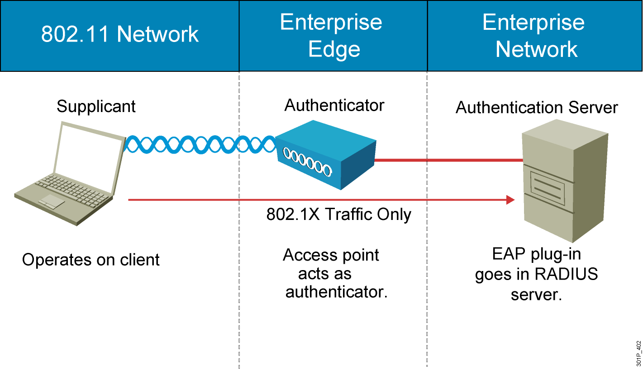
How 802.1X Works on the WLAN
Notes:
The access point, acting as the authenticator at the enterprise edge, allows the client to associate using open authentication. The access point then encapsulates any 802.1X traffic bound for the authentication server and sends it to the server. All other network traffic is blocked, meaning that all other attempts to access network resources are blocked.
Upon receiving RADIUS traffic bound for the client, the access point encapsulates it and sends the information to the client. Although the server authenticates the client as a valid network user, this process allows the client to validate the server as well, ensuring that the client is not logging into a phony server.
While an enterprise network will use a centralized authentication server, smaller offices or business might simply use the access point with preshared keys as the authentication server for wireless clients.

Slide 14
WPA and WPA2 Modes
 | WPA | WPA2
Enterprise mode (Business, education, Government) | Authentication: IEEE 802.1X/EAP Encryption: TKIP/MIC | Authentication: IEEE 802.1X/EAP Encryption: AES-CCMP
Personal mode (SOHO, home and personal) | Authentication: PSK Encryption: TKIP/MIC | Authentication: PSK Encryption: AES-CCMP
Notes:
WPA provides authentication support via IEEE 802.1X and Preshared Key (PSK) (IEEE 802.1X recommended for enterprise deployments). WPA provides encryption support via TKIP. TKIP includes message identity check (MIC) and per-packet keying (PPK) via initialization vector (IV) hashing and broadcast key rotation.
In comparison to WPA, WPA2 authentication is not changed but encryption used is AES-CCMP.
Enterprise Mode
Enterprise Mode is a term given to products that are tested to be interoperable in both PSK and IEEE 802.1x/EAP modes of operation for authentication. When IEEE 802.1x is used, an authentication, authorization, and accounting (AAA) server (the RADIUS protocol for authentication and key management and centralized management of user credentials) is required. Enterprise Mode is targeted to enterprise environments.
Personal Mode
Personal Mode is a term given to products tested to be interoperable in the PSK-only mode of operation for authentication. It requires manual configuration of a pre-shared key on the AP and clients. PSK authenticates users via a password, or identifying code, on both the client station and the AP. No authentication server is needed. Personal Mode is targeted to SOHO environments.

Slide 15
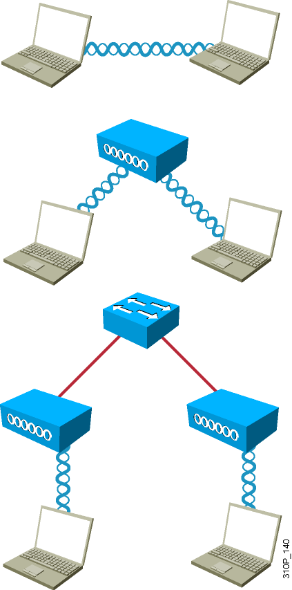
802.11 Topology Building Blocks
Ad hoc mode:
Independent Basic Service Set (IBSS)
Mobile clients connect directly without an intermediate access point.
Infrastructure mode:
Basic Service Set (BSS)
Mobile clients use a single access point for connecting to each other or to wired network resources.
Extended Service Set (ESS):
Two or more BSSs are connected by a common distribution system .
Notes:
Following is a summary of the different WLAN topologies:
Ad hoc mode: This mode is called Independent Basic Service Set (IBSS). Mobile clients connect directly without an intermediate access point. Operating systems such as Windows have made this peer-to-peer network easy to set up. This setup can be used for a small office (or home office) to allow a laptop to be connected to the main PC or for several people to simply share files. The coverage is limited. Everyone must be able to hear everyone else. An access point is not required. A problem is that peer-to-peer networks are difficult to secure.
Infrastructure mode: In infrastructure mode, where clients connect through an access point, there are two modes:
- Basic Service Set (BSS): The communication devices that create a BSS are mobile clients using a single access point for connectivity to each other or to wired network resources. This should not be confused with the Basic Service Set Identifier (BSSID) which is only the layer 2 MAC address of the BSS access point’s radio card. While the BSS is the single building block for wireless topology and the BSS access point is uniquely identified through a BSSID, the wireless network itself is advertised through a Service Set Identifier (SSID). The SSID is a wireless network name that is user configurable. The SSID can be made up of as many as 32 case sensitive characters to announce the availability of the wireless network to mobile clients.
- Extended Services Set (ESS): The wireless topology is extended with two or more Basic Service Sets connected by a distribution system (DS) or commonly a wired infrastructure. An ESS generally includes a common SSID to allow roaming from access point to access point without requiring client configuration.
These are the original standard define 802.11 topologies while other topologies such as repeaters, bridges, and work group bridges are vendor specific extensions.

Slide 16
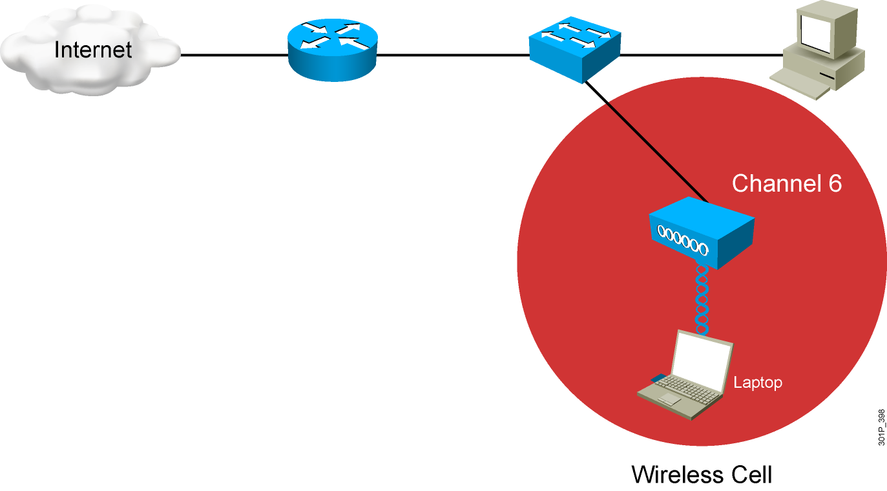
BSA Wireless Topology— Basic Coverage
Notes:
The physical area of radio frequency (RF) coverage provided by an access point in a BSS is known as the basic service area (BSA). This area can is dependant on the RF created with variations caused by access point power output, antenna type, and physical surroundings effecting the RF. While the BSS is the topology building block and the BSA is the actual coverage pattern, there terminology usage are commonly interchangeable for basic wireless discussions.
The access point attaches to the Ethernet backbone and communicates with all the wireless devices in the cell area. The access point is the master for the cell and controls traffic flow to and from the network. The remote devices do not communicate directly with each other; they communicate with the access point. The access point is user configurable with it’s unique RF channel and wireless SSID name.
The access point broadcasts the name of the wireless cell in the SSID through beacons. Beacons are broadcasts that the access points send to announce the available services. It is used to logically separate WLANs. It must match exactly between the client and the access point. However clients can be configured without an SSID (null-SSID), detect all access points, and learn the SSID from the beacons of the access point. A common example of the discovery process is used by the integrated Windows Zero Configuration (WZC) utility when using a wireless laptop at a new location. The user is simply displayed the newly found wireless service and ask to connect or supply appropriate keying material to join. SSID broadcasts can be disabled on the access point but this approach does not work if the client needs to see the SSID in the beacon.

Slide 17
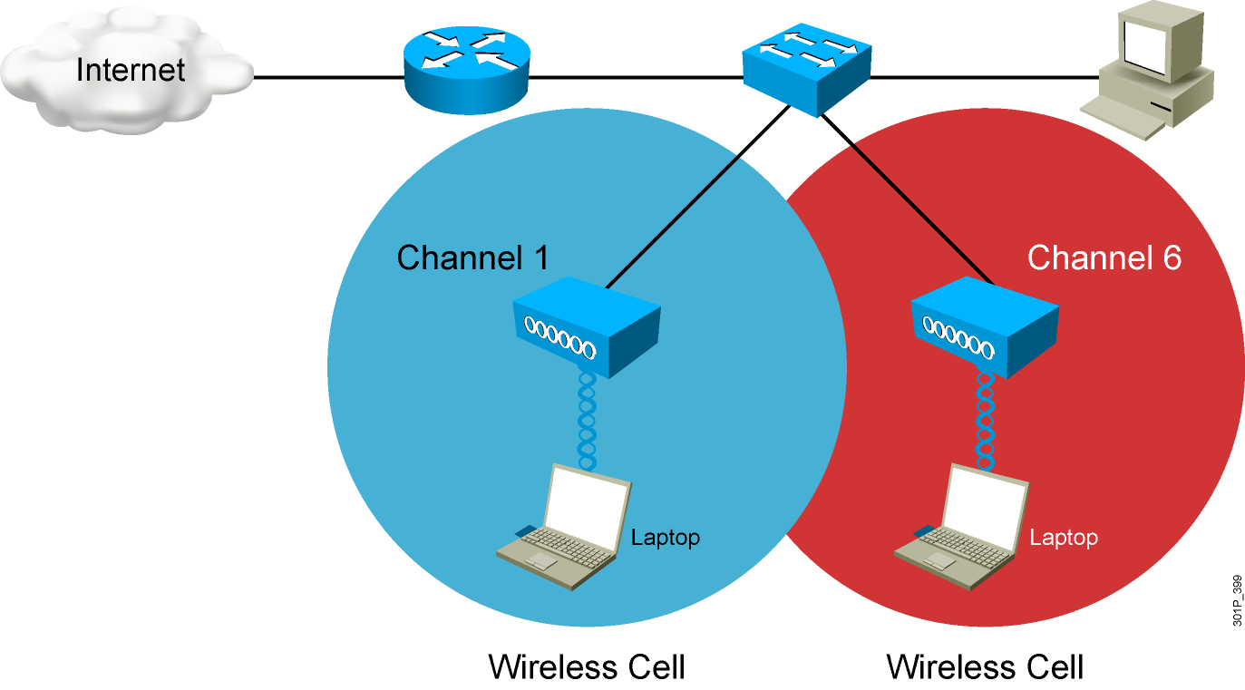
ESA Wireless Topology— Extended Cover
Notes:
If a single cell does not provide enough coverage, any number of cells can be added to extend the range. This range is known as an extended service area (ESA).
It is recommended that the ESA cells have 10 to 15 percent overlap to allow remote users to roam without losing RF connections. For wireless voice networks, an overlap of 15 to 20 percent is recommended. Bordering cells should be set to different non-overlapping channels for best performance.

Slide 18
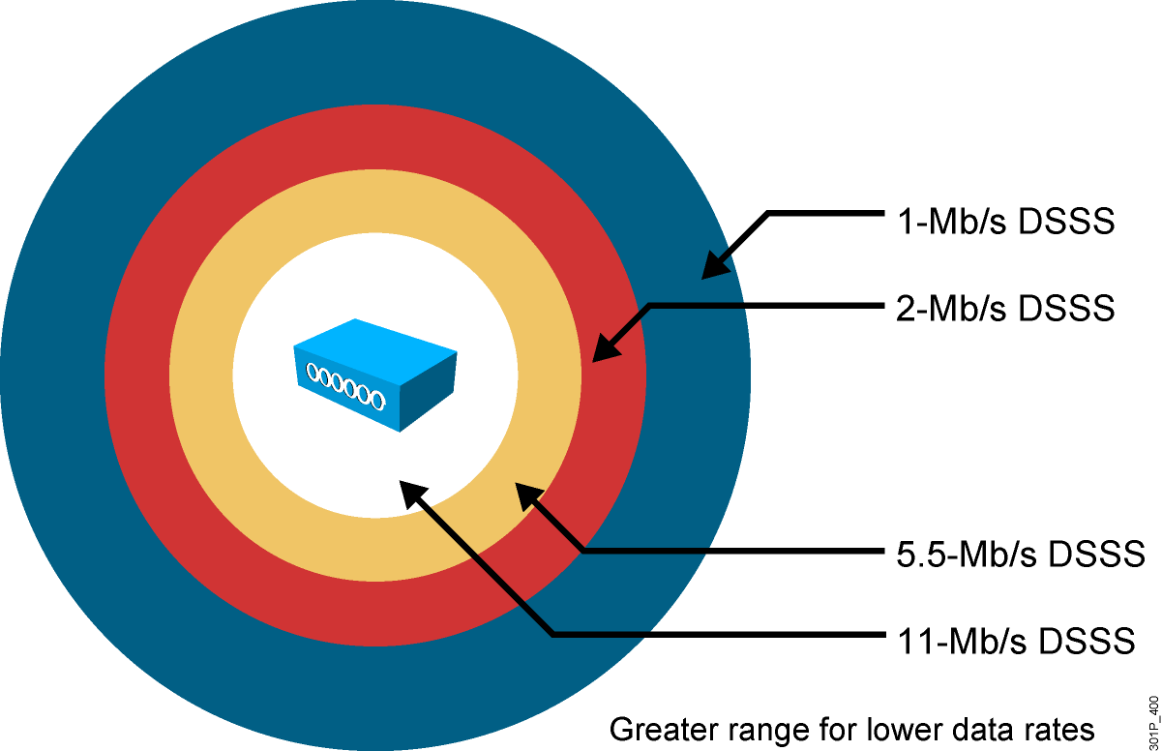
Wireless Topology Data Rates—802.11b
Notes:
WLAN clients have the ability to shift data rates while moving. This technique allows the same client operating at 11 Mbps to shift to 5.5 Mbps, 2 Mbps, and finally still communicate in the outside ring at 1 Mbps. This rate shifting happens without losing the connection and without any interaction from the user. Rate shifting also happens on a transmission-by-transmission basis; therefore, the access point has the ability to support multiple clients at multiple speeds depending upon the location of each client.
- Higher data rates require stronger signals at the receiver. Therefore, lower data rates have a greater range.
- Wireless clients always try to communicate with the highest possible data rate.
- The client will reduce the data rate only if transmission errors and transmission retries occur.
This approach provides the highest total throughput within the wireless cell. The above visual is for 802.11b, however the same concept applies to 802.11a or 802.11g data rates.

Slide 19
Access Point Configuration
Basic parameters:
IP address (static or using DHCP), subnet mask, and default gateway
Wireless protocol (802.11g only, 802.11a/b/g, 802.11a)
Channel adjustment if needed—channel 1,6, or 11 pending interference
Power adjustment if needed—or could change antenna
Security parameters:
Service Set Identifier (SSID)—identifies your network
Authentication method—usually WPA or WPA2 PSK
Encryption method—usually TKIP, or AES if hardware-supported
Notes:
Wireless access points can be configured through a command line interface or more commonly a browser GUI. However, the mode of configuration the basic wireless parameters are the same. Basic wireless access point parameters are SSID, RF channel with optional power, and authentication (security) while wireless client basic parameters only include authentication. Wireless clients need less parameters since the wireless NIC will scan all available RF it’s capable of (meaning an 802.11b/g card can not scan 5 GHz) to locate the RF channel and will usually initiate the connection with a null-SSID to discover the SSIDs available. Therefore by 802.11 design if using open authentication, the result is plug-n-play. When security is configured with Pre-Shared Keys (PSK) for older WEP or current WPA, remember they must be an exact match to allow connectivity.
Depending on the hardware chosen for the access point, it might be capable of both frequencies of 2.4 GHz ISM band and 5 GHz UNII band and all three IEEE 802.11a/b/g implementations. This result will usually allow for fine adjustment of which frequencies to offer through which radio to enable and which IEEE standard to use on that RF. While the details of this related to items such as 802.11b/g Mode versus 802.11g Mode only are not applicable for this course, a basic summary should be observed. When 802.11b wireless clients are mixed with 802.11g wireless clients, the resulting throughput decreases since the access point must start implemented a protection RTS/CTS protocol. Hence if you simply to only one IEEE wireless client type, throughput will be greater than in a mixed mode.
After configuring the basic required wireless parameters of the access point, additional fundamental wired side parameters must be configured for default router and DHCP server. Given a pre-existing LAN, there must be a default router to exit the network and a DHCP server to lease IP addresses to wired PCs. The access point simply uses the existing router and DHCP servers for relaying IP address to wireless clients. Since the network has been expanded, verify the existing DHCP IP address scope is large enough to accommodate the new wireless client additions. If this is a new installation with all router and access point functions in the same hardware, then you simple configure all parameter in the same hardware.

Slide 20
Steps to Implement a Wireless Network
Step 1: Verify local wired operation—DHCP and ISP.
Step 2: Install the access point.
Step 3: Configure the access point—SSID, no security.
Step 4: Install one wireless client—no security.
Step 5: Verify wireless network operation.
Step 6: Configure wireless security—WPA with PSK.
Step 7: Verify the wireless network operation.
Notes:
The basic approach to wireless implementation (as with any basic networking) is to gradually configure and test incrementally.
Before any wireless, verify pre-exiting network and internet access for the wired hosts. Then implement wireless with only a single access point and single client without wireless security. Verify the wireless client receives a DHCP IP address and can ping the local wired default router and then browse to the external Internet. Lastly, configure wireless security with WPA. Only use WEP if hardware equipment is too old to support WPA.

Slide 21
Wireless Clients
Wireless Zero Configuration (WZC):
Default on Windows XP or later operating system
Limited features for basic PSK
Verify that users have the correct encryption type and password
Cisco Compatible Extensions Program
Accelerated feature deployment of third-party clients
Wide deployment of various vendors
Cisco Secure Services Client
Enterprise full-featured wireless client supplicant
Wired and wireless
Notes:
Currently there are many form factors to add wireless to existing laptops. The most common are USB devices with self contained fixed antenna and wireless supplicant software to enable wireless hardware usage and provide security options for authentication and encryption. Most new laptops being produced today already contain some form of wireless thereby increasing the wireless market and easy of use. Even newer windows operating systems have basic wireless supplicant client (WZC) to enable wireless plug-n-play by discovering SSIDs being broadcasted and allow the user to simply type the matching security PSK for such items as WEP or WPA. The basic features of WZC satisfy more simple SOHO environments.
Large enterprise networks will require more advance wireless client features than those of native operating system. Cisco started a program of value add feature enhancements through a royalty free certification program starting in 2000. Over 95% of Wi-Fi laptop enabled laptop shipped today are Cisco Compatible Extension (CCX) compliant. Details and status of version and features can be found on www.cisco.com. The following is a table summary of version and features:
Ver Topic Example
V1 Security Wi-Fi Complaint; 802.1X, LEAP, CKIP
V2 Scaling WPA, AP-assisted roaming
V3 Performance & Security WPA2, WMM,
V4 Voice over WLAN CAC, Voice metrics, UPSD
V5 Management and IPS Management Frame Protection, Client reporting
Enterprise networks were still managing one set of wired clients and another set of wireless clients. Cisco offers a full feature supplicant for both wired and wireless client call Cisco Secure Services Client. The benefit to users is a single client for wired or wireless connectivity and security.

Slide 22
Common Wireless Network Issues
Most problems are due to incorrect configuration:
Verify that the access point is running the latest revision of firmware.
Verify the channel configuration. Try channels 1, 6, or 11.
Verify that users have the correct encryption type and password.
Other common problems:
RF interference
Not connected
Radio not enabled
Poor antenna location
Notes:
If you follow the prior stated steps for implementing wireless network, the divide and conquer technique via incremental configuration will most likely lead to most likely cause. Most common configuration issues are :
Configuring a defined SSID on the client (versus it’s discovery method of SSID) that does not match access point (inclusive of case sensitivity).
Configuring incompatible security methods. Both wireless client and access point must match for authentication method (EAP or PSK) and encryption method (TKIP or AES).
Other common problems resulting from initial RF installation: - Is the radio enabled on both the access point and client for the correct RF (2.4 GHz ISM or 5 GHz UNII)? - Is an external antenna connected and facing correct direction (straight upward for dipole)?
- Is the antenna location too high or too low relative to wireless clients (within 20 vertical feet)?
Metal object in the room reflecting RF and causing poor performance ?
Attempting to reach too great of a distance capable ?

Slide 23
Wireless Troubleshooting
Locate the access point near the center of your home or office.
Avoid mounting the access point next to metal objects.
Keep the access point out of the line of sight of devices that contain metal.
Verify connectivity without the security of PSK.
Avoid RF interference from other equipment (gaming, monitors, phones).
If the home or office is large, you may need two or more access points.
Make sure the access point works over a unique channel not in use by other adjacent access point deployments.
Notes:
Troubleshooting wireless by breaking the environment into wired network versus wireless network. Then further divide the wireless network into configuration versus RF issues. First verify the proper operation of the existing wired infrastructure and associated services. Verify other pre-existing Ethernet attached host can renew their DHCP address and reach the Internet. Then co-located both the access point and wireless client together to verify configuration and remove issues of possible RF since they are both co-located. Always start the wireless client on open authentication and establish connectivity. Then progress with desired for of wireless security. If wireless client is operational at this point of co-location, then only RF related issue remain. First consider if metal obstructions exist. If so, then move the obstruction or location of access point. If the distance is too great, consider adding another access point using same SSID but unique RF channel. Lastly but more common to consider is RF environment. Just like a wired network can become congested with traffic, so can RF for 2.4 GHz more often than 5 GHz. Are there other sources of wireless devices using 2.4 GHz. Note if performance issue seem to relate to time of day which would indicate the usage pattern of suspect RF interference device. Easy example would be slow performance that relates to noon time in the office near the break room where there is a microwave oven used for employees to heat up lunch. While most microwave will practically RF jam channel 11, other microwave based on manufacture will jam all RF channels. More difficult might be RF devices that hop frequencies like FHSS used in cordless phones. Since there can be many sources of RF interference, always start with co-locating the access point and wireless client and then move the wireless client until reproducing the problem. Most often, wireless clients will have supplicant software to assist in the effort by presenting relative RF signal strength and qualify.

